Slide 1

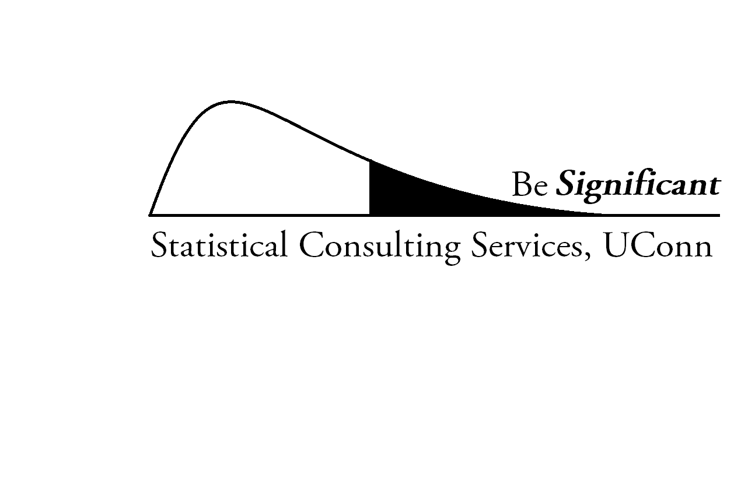

Statistical Consulting Walk-In Services (SCSWS*)
Department of Statistics (www.stat.uconn.edu)
College of Liberal Arts and Science
FREE STATISTICAL CONSULTING!!
Available To: All UConn undergraduate and graduate students, postdocs, research fellows, faculty members.
We can Help with: Quick Questions about Journal articles, PhD. Dissertations, M.S. Theses and Undergraduate projects. If it requires more than 30 minutes, we can initiate a project with one of our consultants separately to work with you. You can apply online at http://merlot.stat.uconn.edu/www/consulting/application
Students please note: We won’t be able to help with your course projects or homework! Sorry.
Who We Are: Graduate assistants in the Department of Statistics, working under the guidance of Dr. Ming-Hui Chen, Director of Statistical Consulting Services (SCS).
What We Know: Design of clinical trials, Regression Analysis, Meta-Analysis, Factor Analysis, (M)ANOVA, ANCOVA, HLM, Categorical Data Analysis, Handling Missing Data, Repeated measures, High-dimensional data, (Non) Linear Mixed Modeling, Time Series and more.
Software Expertise: SAS, SPSS, R, Stata, Minitab, AMOS, MPlus, Excel and more.
Where We Are: Philip E. Austin Building (Former CLAS), Room 340
Walk-In Hours (Spring 2015):
Monday: 9AM – 5PM
Tuesday: 3:30PM – 6:30PM
Wednesday: 9AM – 12PM
Thursday: 3:30PM – 6:30PM
Friday: 9AM – 3PM
*SCSWS is jointly funded by Office of the Vice President for Research (OVPR), Dean’s Office, CLAS & Department of Statistics, UCONN

